Slide 1

BCE Digital Twins Final Presentation
5.09.2023

Slide 2

AGENDA
01 | Introductions
02 | What is a Digital Twin
03 | Digital Twin Market
04 | Consumer Products & Life Science Case Story
05 | Supplementary Real World Use Cases
06 | Implementation Partners
07 | Consulting Competitive Analysis
08 | Final Takeaways / Recommendations
09 | Appendix (detailed case studies, details about implementation)

Slide 3





Meet the Babson Team
DEREK ROBERTS
MBA Candidate
SHILPHI CHAUDHARY
Derek has 5 years of experience leading Army Special Operations teams in dynamic austere environments. Experience organizing, planning and executing projects with focuses on excellence, innovation and resiliency.
MBA Candidate
Shilphi has 5 years of experience working as a lawyer at law firms. She consulted global clients, performed thorough investigation, and generated insights. As an attorney, she also negotiated with multiple stakeholders to obtain desired outcomes. She is looking to utilize her skills to move into strategy consulting.
CAPE ELIZABETH, ME
VISHNU KARIYATTU
RALEIGH. NJ
BIHAR, INDIA
MBA Candidate
Vishnu spent 9 years leading projects in Oil & Gas sector, and US Army Base in Kuwait and helping companies in Digital Transformation in UAE. Areas of specialization include Project Management, Strategy Transformations and Forensic Delay Analysis.
SRISHTI DIWAN
MBA Candidate
Srishti has worked as an Audit Associate at Ernst and Young for 3 years post that managed her family export house for 4 years, having cleared CFA Level 1, she is now looking to pivot to financial strategy roles post her MBA.
KERALA, INDIA
ISHAAN JAIN
MBA Candidate
Ishaan spent 2 years building a sports management company, managing sports athletes and executing sports events. And later he pivoted to leading over 10 teams across 6 functions for a flatware/ kitchenware brand in India.
RALEIGH. NJ
NEW DELHI, INDIA
NEW DELHI, INDIA

Slide 4
Defining Digital Twins
2
1
Technology creates a digital representation of the physical world by capturing data from sensors, IoT devices, and other sources that are used to monitor and control the physical object or system.
Virtual replica of a physical
object, process, or system that is used for simulation, analysis, monitoring, and optimization.
Digital
Twin
Continuous advancements in
technology and increasing
availability of data, digital twin technology is expected to play an increasingly significant role in shaping the future of various industries.
Data used to create a virtual model that can be used to simulate and analyze different scenarios, predict performance, and optimize operations.
3
4
Notes:
https://www.ibm.com/topics/what-is-a-digital-twin
https://www.marketsandmarkets.com/Market-Reports/digital-twin-market-225269522.html
https://www.gartner.com/en/newsroom/press-releases/2019-02-20-gartner-survey-reveals-digital-twins-are-entering-mai

Slide 5
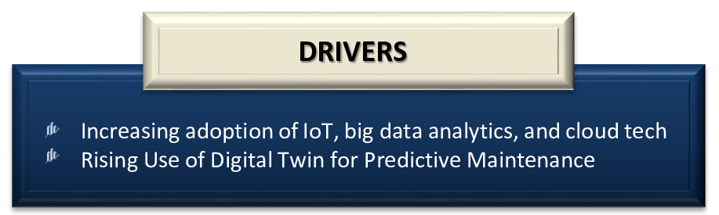
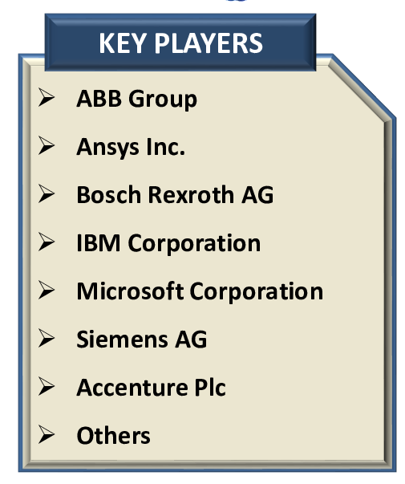
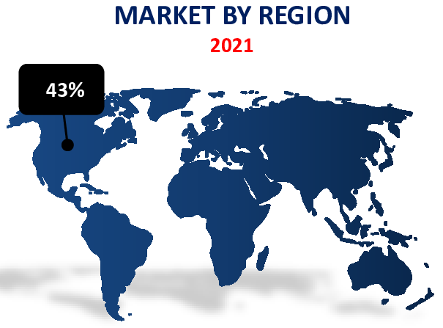
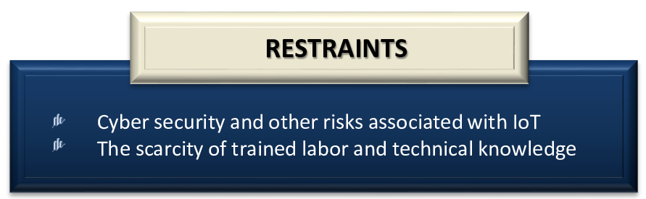
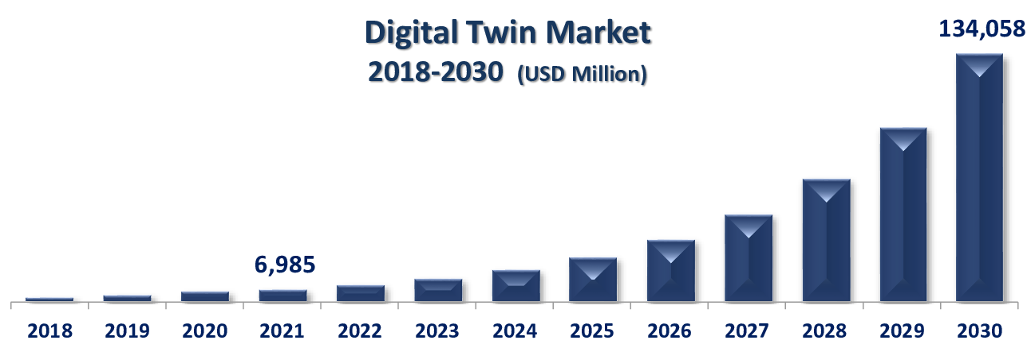
Digital Twins | Key Trends & Market
13% of organizations implementing IoT project already use Digital Twin. 62% are in the process of establishing or plan to do so within the next year.
- Gartner
70% of C-suite technology executives at large enterprises are exploring and investing in digital twins.
- IoT Analytics
39.3% CAGR (2022-2030)
Notes:
https://www.acumenresearchandconsulting.com/digital-twin-market
According to NavVis a Germany-based digital twin provider, the use of NavVis Digital Twin has surged by nearly 300% post COVID-19 physical distancing measures
Optimize operation and reduce down time and operation cost
Over the next decade, the company estimates that its digital twins will deliver billions of dollars in cumulative financial impact as they enable additional AI use cases and increase the amount of data-driven decision making across the organization

Slide 6
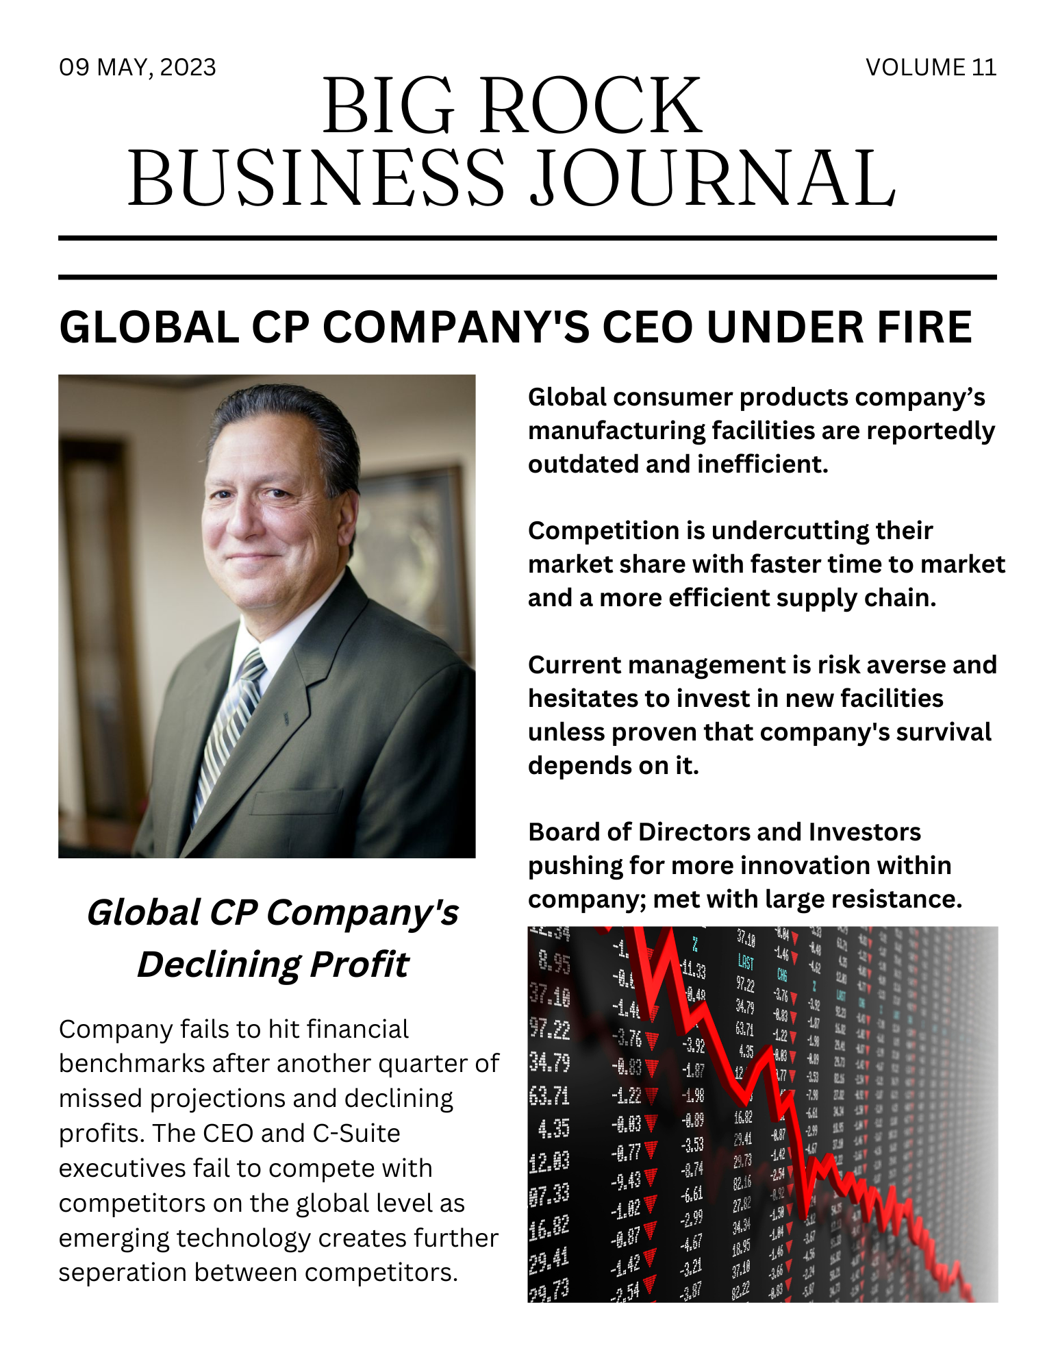
Headline News!

Slide 7



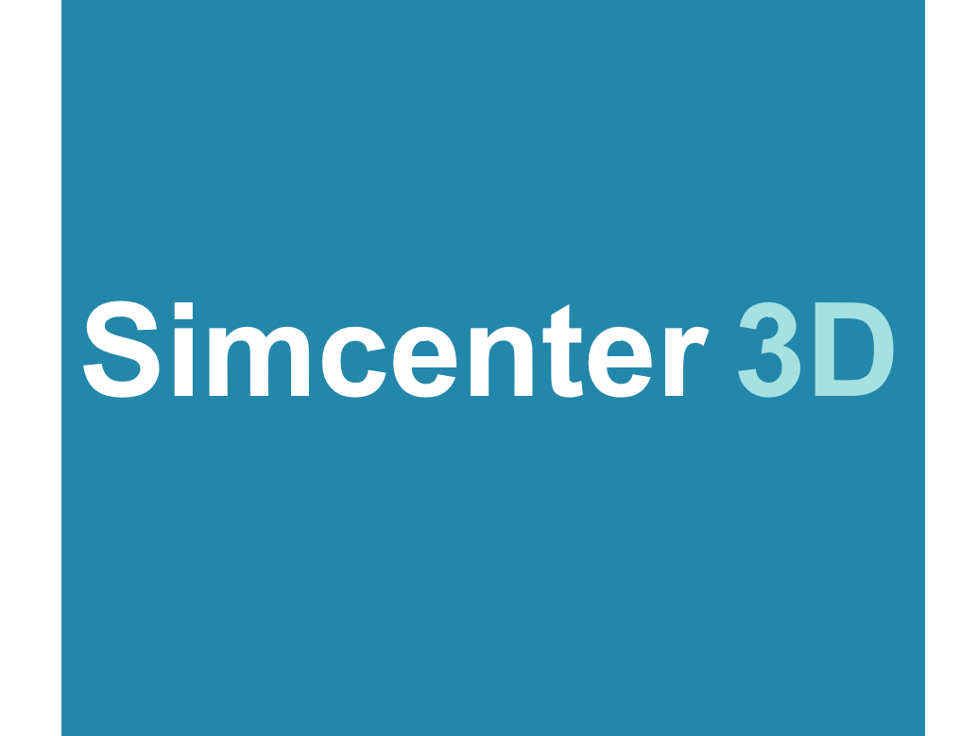

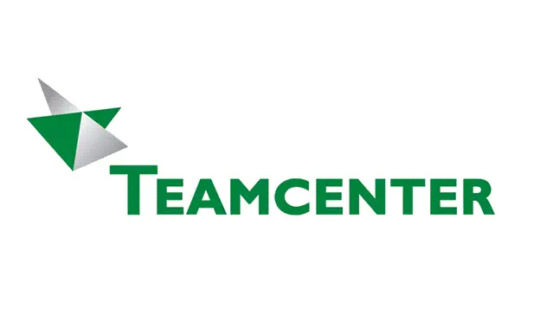
Sam’s Dilemma - Board wants Results!
Sam Thompson
Company must identify and quantify current factory’s performance and KPI’s. Identify processes for improvement and create performance and KPI goals.
They conduct research and identify opportunities for process improvement. Selects Siemens for technology implementation partner.
Sam’s team presents innovation opportunity to the CEO and Board of Directors for overall innovation improvement.
Operations team implements test run of Siemen’s portfolio in manufacturing and operations process.
SVP of Operations
Los Angeles, CA
“We need to continue innovating in order to remain competitive in the current marketplace”
Notes:
https://assets.new.siemens.com/siemens/assets/api/uuid:610b5974-241d-4321-8ae6-55c6167446bf/bim-digitwin-ru.pdf
https://assets.new.siemens.com/siemens/assets/api/uuid:ce77eef2-3ae4-4910-9d88-e57697aa0196/SimulationDigitalTwinOutlook2030.pdf
https://assets.new.siemens.com/siemens/assets/api/uuid:3a888b679aaf5feeb7cf9eacfe8806aa0c6046b6/factsheet-cct-simulation-and-digital-twin-en.pdf
https://assets.new.siemens.com/siemens/assets/api/uuid:66c9013092b493265e091c154a33f9dd38d36c20/electricaldigitaltwin-brochure-final-intl-version-singlepages-no.pdf

Slide 8
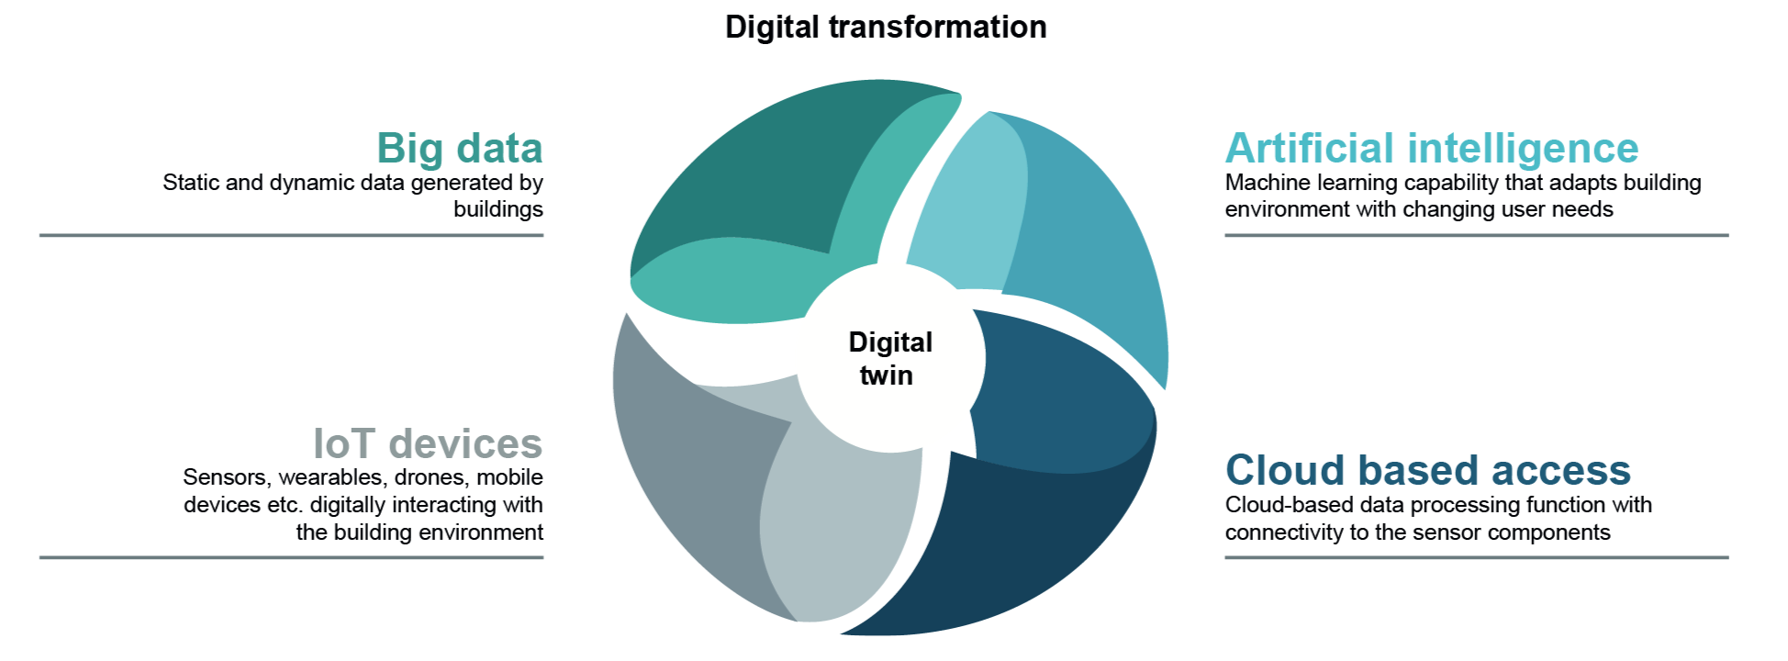
Sam’s Digital Twin Integration
Integrated a multi-level digital platform with IoT sensors for data collection, simulation trials, machine learning and predictive analytics.
Completed two month digital twin pilot trial; yields drastic results for company.
Reduction in total operational costs, improved budget reliability and faster product delivery.
Board agrees on full scale digital transformation to roll out Digital Twin technology across all aspects of the company.
Basis for Life
Cycle Cost
Optimization
Up to
lower total operational costs
Improved
Budget
Reliability
Up to
decrease in non
budgeted change
orders
Faster
Project
Delivery
Up to
shortened
project timeline
9%
40%
7%
Notes:
https://assets.new.siemens.com/siemens/assets/api/uuid:610b5974-241d-4321-8ae6-55c6167446bf/bim-digitwin-ru.pdf

Slide 9
Summary
Company losing profits
and market share to competitors with
emerging
technology
Operations team strategized innovation options for solving their current problem
Integrated Siemens Digital Twin portfolio a cross multiple levels of the business
Reduced several cost metrics and increased project delivery time
and efficiency
01
SITUATION
02
TASK
03
ACTION
04
RESULTS

Slide 10


Implementer | A New LS Client
Sam, tells his friend Sally, who is working as the head of R&D at a known Life sciences company about the technology.
Sally speaks to the manufacturing team, the management and hence company starts researching and looking into the technology.

Slide 11
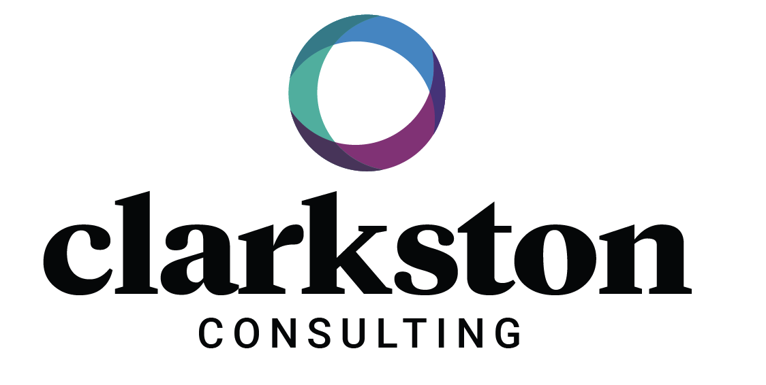

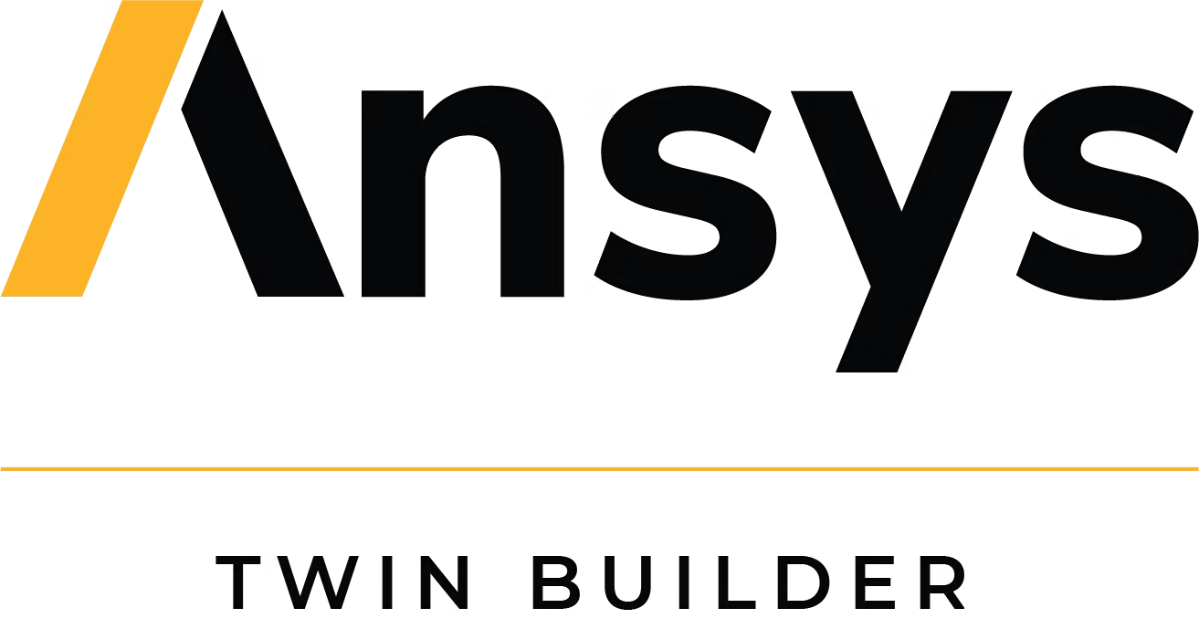
Enter Clarkston
Sally hires Clarkston’s consultants to understand the scope and if feasible, implement this technology for their company with other technology implementers.
After a few months of research and analysis, Clarkston suggests Sally and company to implement this technology with Ansys.
Clarkston implements sample simulation with Ansys Twin Builder to find that the technology will help their client improve manufacturing efficiency by 40 % and reduce time to market for a new cancer prevention by 20%.
Platform for building, validating, and deploying digital twins. It includes tools for modeling, simulation, and analytics and can be used for medical devices, drug development, and patient simulations.
*Refer to detailed software implementation with Ansys in Annexure- page 56

Slide 12


FDA, Implementation & Benefits
The process is submitted for FDA’s approval.
FDA analyses the digital twin implementation process for drug manufacturing and approves the drug to be produced in small batches for clinical trials.
Phase I, II and III of human trials are conducted and during this phase the predictive modelling used in digital twins is perfected further to make the drug better and this in turn is incorporated back into the manufacturing process to optimize the process.
Best version of the drug is created for mass production.
FDA approves the newly developed drug for mass production.
Digital Twin tech is used to optimize the production process, the supply chain for distribution, collection of data (how effective the drug is), and predicting the future positive & defective nature of the drug.
Identified/optimized data for planning, sourcing and quality
Reduced equipment failure by 30%
Reduced revenue loss
Improved product quality by 40%
Helped improve manufacturing efficiency by 15%
Got FDA approval for launch of new drugs in the space.
FINAL PRODUCTION AND BENEFITS !

Slide 13
Digital Twin Research & Implementation Timeline
Research
Action
Recommendation
Results
Sally’s team starts researching the technology and capabilities
The team hires Clarkston to understand scope and implementation
Clarkston recommends integrating Ansys for the implementation of the technology.
Ansys Technology implemented with the help of Clarkston’s Team
2 weeks
Identify performance metrics and growth opportunities that need improvement
Outline strategy and goals that would like to be achieved related to researched metrics
4 weeks
Clarkston conducts internal & external research and analysis
Identifies areas of improvement in R&D and Manufacturing
Clarkston helps outline possible solutions for Sally’s Team
6 weeks
Clarkston suggests investing in Ansys Twin Builder
Platform for building, validating, and deploying digital twins.
Includes tools for modeling, simulation, and analytics.
Used for medical devices, drug development, and patient simulations.
4 weeks
Clarkston oversees and advises on the implementation.
Assists company in understanding data and KPIs
Clarkston helps ensure FDA compliance in R&D modeling and manufacturing

Slide 14

Use Cases | Consumer Products
COCA-COLA
CELLI GROUP
NESTLE
WALMART
AWS Portfolio
20+ pts of optimization in equipment cleaning process
Reduced electricity use by 20%, annual savings 156,000 kWatt for 60 systems
Reduced water usage 9%, CCI could save 90k tons for 60 systems
Added 34 days to the production schedule by streamlining
Microsoft Azure / PTC
Achieved >14% sell through via enhanced sales/inventory mgmt.
Reduced equipment failure by 13% reducing revenue loss
Improve product quality by 27% by monitoring temp, self-life and sanitation cycle
Predictive maintenance reduced service costs by 10%
Siemens Mindsphere
$38,500 annual cost reduction in water & chemical utilization
23% decrease in median kettle heating time
Reduced employee # in production planning phase by 0.5 FTE
Optimized cooking & clean in place (CIP) process further reducing cost
Macy’s pilots Zeekit Digital Twin changing room model
Online Sales increase 43%
Zero items purchased using software returned
Walmart purchases company for $200m
Uploads 270,000 items across Walmarts portfolio
Personalized shopping experience using customer data
Zeekit - 3D Modeling
*Refer to details of every use case/ story in annexure from page 30-38

Slide 15
Use Cases | Life Sciences
BIG PHARMA: COMP X
MEDTRONICS
MAMMOGRAPHY
KPMG Digital Twin
Identified/optimized data for planning, sourcing and quality
Built multi-step predictive models using advance machine learning algorithms
Improved service lead time and manufacturing cost
Reduced steps predicted by >40% by obtaining outcome predictions and yields
Achieved >14% sell through via enhanced sales/ inventory management.
Reduced equipment failure by 13% reducing revenue loss
Improve product quality by 27% by monitoring temp, self-life and sanitation cycle
Predictive maintenance reduced service costs by 10%
Microsoft Azure
FDA team simulated the Virtual Imaging Clinical Trial for Regulatory Evaluation (VICTRE) study for digital breast examinations.
2,986 silico patients created to evaluate performance of Digital Breast Tomosynthesis (DBT) as a replacement of full-field digital mammography
VICTRE
*Refer to details of every use case/ story in annexure from page 39-43
Notes:
Medtronic
https://www.supplychainmovement.com/digital-twin-helps-medtronic-to-save-time-in-supply-chain/

Slide 16
Competitive Analysis
McKinsey & CO.
Strategy
Defining an organization’s digital twin target-future state
Developing and quantifying the business case
Creating and pressure testing digital twin roadmap
Implementation
Assisting program management and steering transformation and implementation of prioritized use cases.
Maximizing value by helping to build organization-wide digital twin capabilities, supported by change management expertise to help users thrive in the new working model.
Technology
Defining technical architecture data and tool chain for a broader PLM and digital twin transformation
Guiding the development of machine learning -based surrogate models to optimize product design
Partnering with clients to connect the multiple advanced simulation models that deliver a system twin.
Industry
R&D, Manufacturing, and Service
Notes:
https://www.mckinsey.com/capabilities/mckinsey-digital/our-insights/digital-twins-the-foundation-of-the-enterprise-metaverse

Slide 17
Ernst and Young
Strategy
Life Sciences - A digital twins operating model can drive efficiencies, reduce errors and deliver better patient outcomes for cell and gene therapy companies.
Implementation
Establishing decentralized point-of-care manufacturing facilities (their own or externalized) to reduce logistics lead times and therapy costs and to be closer to patients so they can be better served
Investing to re-evaluate their operating model, redesign their processes, and further digitize and automate operations for greater agility and efficiency without compromising quality control
Strategy
Consumer Product - Four challenges keep supply chain leaders up at night:
1. Operational excellence improvement 2. Scalability and speed of deployment across multiple lines/operations 3. Internet of things return on investment 4. Building a performance culture
Implementation
Smart Factory capabilities:
1. Offers real-time, on-demand performance progress reports visible across the production chain
2. Provides the information and technologies to improve physical process control
3. Refines processes and master production through advanced analytics
4. Enables flexible, adaptive and proactive production
5. Facilitates end-to-end integration with suppliers and customers
Technology
Cell and gene therapy companies are investing to develop future-ready capabilities and transforming to meet the needs and complexities of the end-to-end value chain.
Technology
EY Smart Factory helps manufacturing executives develop, implement and drive global operational excellence programs in a connected and centrally controlled system. It offers access to an extensive database of leading practices, methodologies, tools, training and analytics.
Industry - Consumer Product
Industry - LifeSciences
Notes:
https://www.ey.com/en_us/life-sciences/how-digital-twins-and-the-cell-and-gene-therapy-value-chain-offer-possibilities
https://www.ey.com/en_us/consulting/smart-factory

Slide 18
Deloitte
Strategy
Develop new manufacturing process by accelerating the experimentation using digital twin.
Implementation
Pharma manufacturing may require manual processes
Build digital twin for each process step
Build separate digital twin as a controller to link all parts to automate the flow
End-to-end simulation of the manufacturing process gets built
This expedites the entire experimentation and helps generate data to enable more informed decisions
Strategy
Utilize digital twin to expand into price-per-kilometer (PPK) subscription model with products appropriately priced to win business from large fleets
Implementation
Capture the multidimensional information about the tire-performance using digital twin, even if no data is still available.
Digital simulations and analytics are applied over digital twin data
Derive insights that inform decisions around the cost of maintenance, rotations, etc., thereby deriving appropriate pricing for PPK
Help fleets select the appropriate tires for their specific driving conditions and reduce tire wear or avoid breakdowns
Technology
Virtual representations of the manufacturing processes.
Technology
Utilized digital twin to understand factors affecting tire’s lifespan
Employ data analytics to provide insight to define PPK for fleets
Industry - LifeSciences
Industry - Tire and rubber manufacturing
Notes:
https://www2.deloitte.com/us/en/insights/focus/tech-trends/2020/digital-twin-applications-bridging-the-physical-and-digital.html

Slide 19



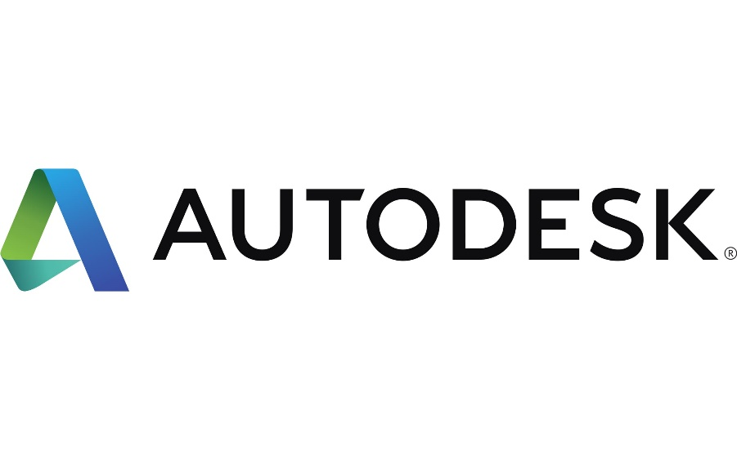

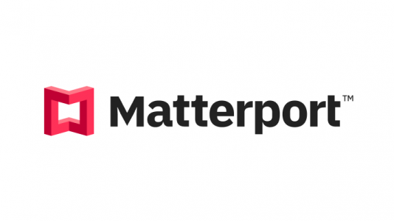


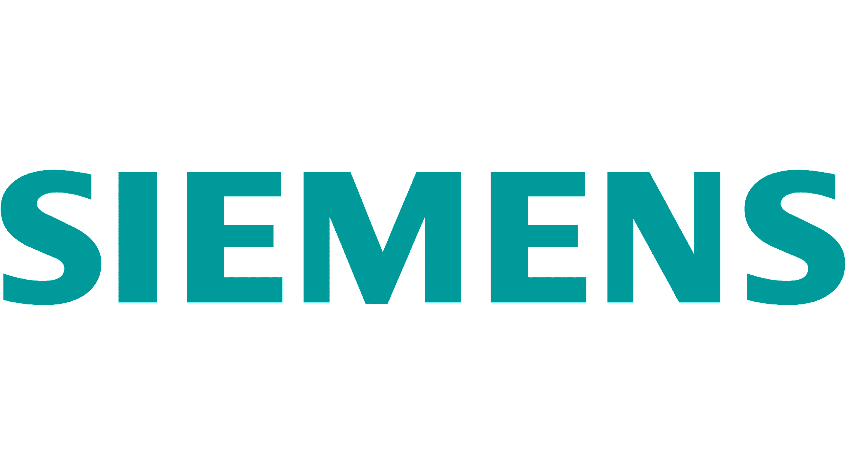



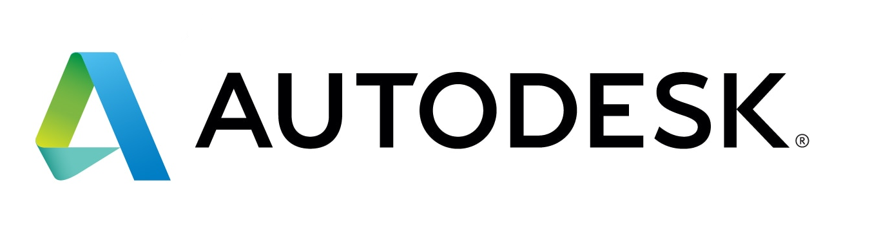

Technology Implementers
Consumer Products
Manufacturing
*Refer to details of all implementers and their platforms in annexure- page 51-60
Life Sciences
E-commerce

Slide 20
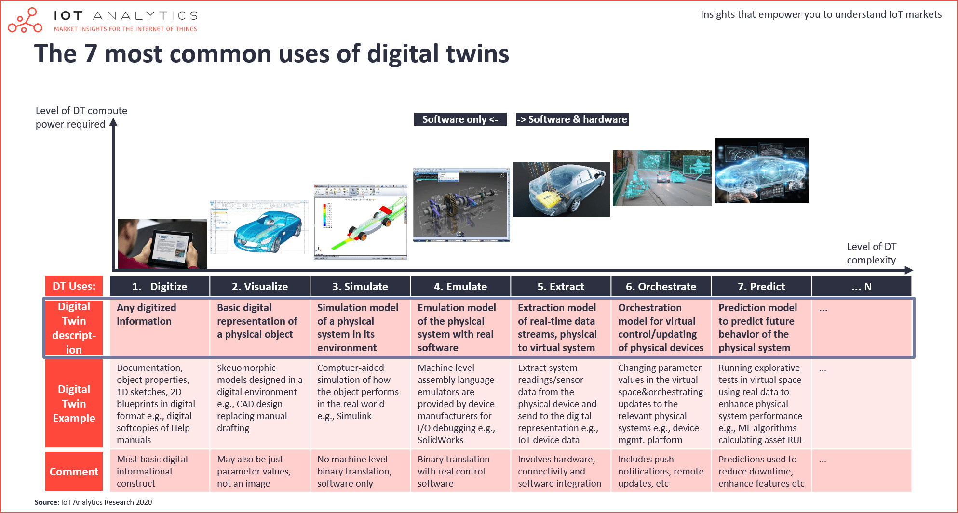

Digital Twin | Implementation Process Flow
Digitize
Visualize
Stimulate
Emulate
Extract
Orchestrate
Predict
Any digitized information
Basic digitized representation of a physical copy
Simulation of a physical system in its environment
Emulation model of a physical system with the real software
Extraction model of real time data streams, physical to virtual system
Orchestration model for virtual control/ updating of physical devices
Prediction model to predict future behaviour of physical system
Most basic informational construct like 1d sketches, 2D blueprints
Skeuomorphic models designed in a digital environment like CAD designs
Computer aided simulation of how the object performs in the real world.
Machine level assembly language emulators
Incorporate and extract data from physical sensors/ readings
Updating data into digital twin and transferring updates to physical systems
Running simulations & continuously assimilating real world data to refine the output
*Refer to details of implementation and digital twin architecture from page 45-49

Slide 21
Insights & Results
BECOMING A GREENER AND EFFICIENT COMPANY
Reduce electricity and other resource wastage - Between 9-25% depending on industry and proficiency on learning curve
DIGITAL TWIN IS THE WAY TO GO!
BE ON THE FOREFRONT OF COST CUTTING/EQUIPMENT FAILURES
Reduce costs between 10-20% and equipment failure rates up to 13%
IMPROVE PRODUCT QUALITY/ INCREASE ONLINE SALES
Increase product quality up to 30% and increase online sales up to 50%
BE ON THE FOREFRONT OF SUPPLY CHAIN DECISION MAKING
Up to 35% more efficient in supply chain decision making

Slide 22
Summary | What We Have Learned
What we have learned so far!
Digital twin overview summary
Sam’s CP Success Story
Sally’s LS Success Story
What Peers & Competition is doing!
Implementors & Implementation Process
Insights & Results

Slide 23
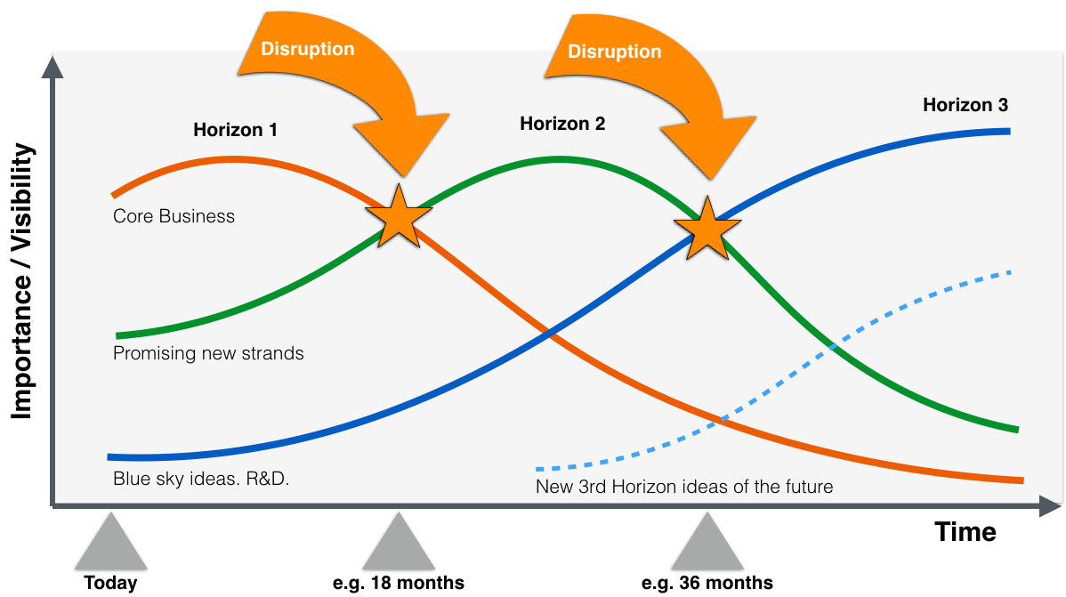
McKinsey's THREE
HORIZONS DECISION
MATRIX
Will Clarkston be able to implement Digital Twins?
Horizon 1 - Maintain & defend core business: Focuses on leveraging existing products and services for improving margins, improving current business processes, and increasing short-term profits.
Horizon 2 - Nurture emerging business: Focuses on taking what you already have and extending it into new areas of revenue-driving activity. Trying new approaches as a response to the shifts in the market. Focus on creating new innovations in the existing market or exploring new markets. May incur additional initial cost, but these investments should return fairly reliably.
Horizon 3 - Create genuinely new business: Third and most distant of the planning horizons. Encompass up to 10 years or more and focuses on creating opportunities, exploring new markets, and making discretionary investments to capitalize on those opportunities.
We believe large scale implementation of DIGITAL TWINS will be a Horizon 2 decision for Clarkston Consulting.

Slide 24
FINAL RECOMMENDATION
IDENTIFY
GAPS
IMPLEMENTATION PARTNER
ONBOARD AND IMPLEMENT
Identify various avenues where the digital twin technology can be implemented in life sciences and consumer products based on Babson MBA consulting team’ s research
Categorize the gap areas into horizon 1, 2 and of the implementation processes
Identify and finalize an implementer from the recommended list provided by BABSON MBA team for each of Horizon 1, 2 and 3 implementations (Siemens is recommended).
Onboard the implementer and demonstrate changes to clients in horizon 1 gap areas.
Convince and onboard clients for horizon 2 implementation.

Slide 25
APPENDIX

Slide 26
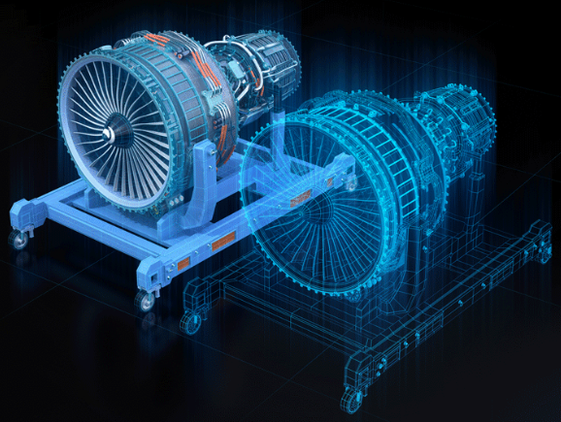
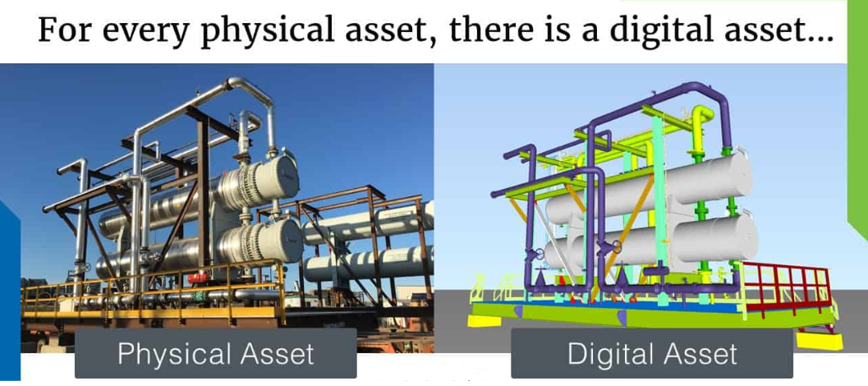
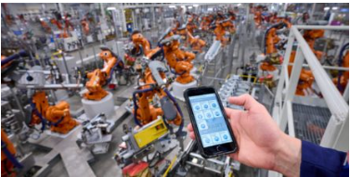
Different Types of Digital Twins
COMPONENT/PART TWINS.
Component twins are the basic unit of digital twin, the smallest example of a functioning component.
Parts twins are roughly the same thing, but pertain to components of slightly less importance.
ASSET TWIN.
When two or more components work together, they form what is known as an asset.
Asset twins let you study the interaction of those components, creating a wealth of performance data that can be processed and then turned into actionable insights.
SYSTEM / UNIT TWINS.
The next level of magnification involves system or unit twins, which enable you to see how different assets come together to form an entire functioning system. System twins provide visibility regarding the interaction of assets, and may suggest performance enhancements.
PROCESS TWIN.
Process twins, the macro level of magnification, reveal how systems work together to create an entire production facility. Are those systems all synchronized to operate at peak efficiency.
Process twins can help determine the precise timing schemes that ultimately influence overall effectiveness.
Notes:
The biggest difference between these twins is the area of application.

Slide 27
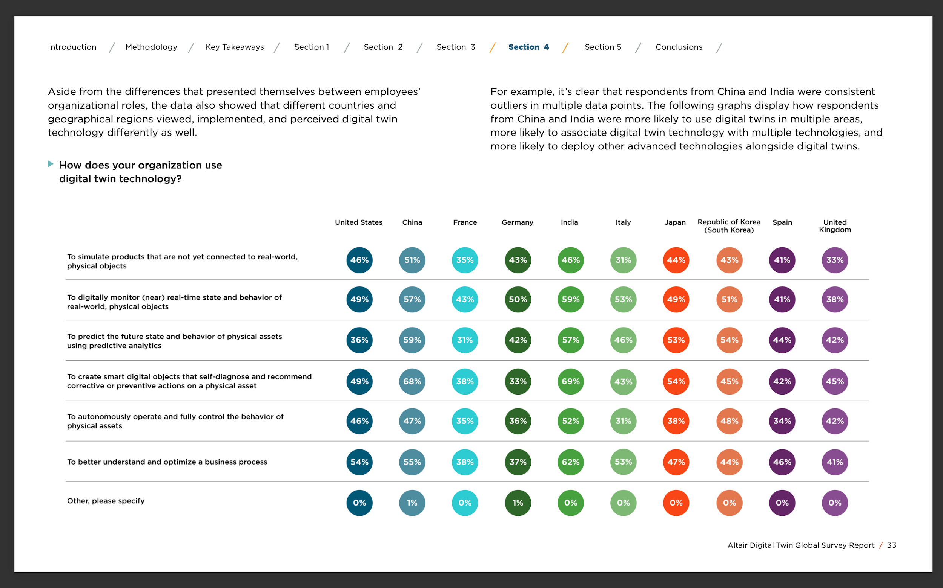
Digital Twin | Geographical Overview
Altair commissioned an independent, international online survey of 2,007 professionals employed throughout many target industries who perform job functions related to data science, IoT and analytics, software engineering, research and development (R&D), engineering, information technology (IT) and information systems (IS), product development, and executive management.
# of Professionals Surveyed by Country:
• United States (N=200)
• China (N=200)
• France (N=200)
• India (N=206)
• Germany (N=200)
• United Kingdom (N=201)
• South Korea (N=200)
• Italy (N=200)
• Japan (N=200)
• Spain (N=200)
Notes:
https://altair.com/docs/default-source/pdfs/altair_dt-global-survey-report_web.pdf?sfvrsn=b5aceaa9_28

Slide 28
USE CASES | EVALUATION

Slide 29
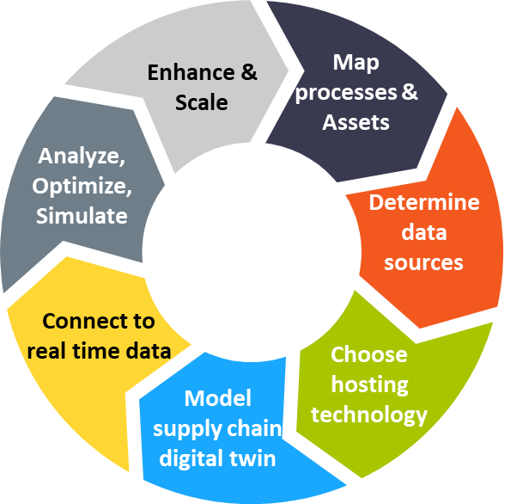
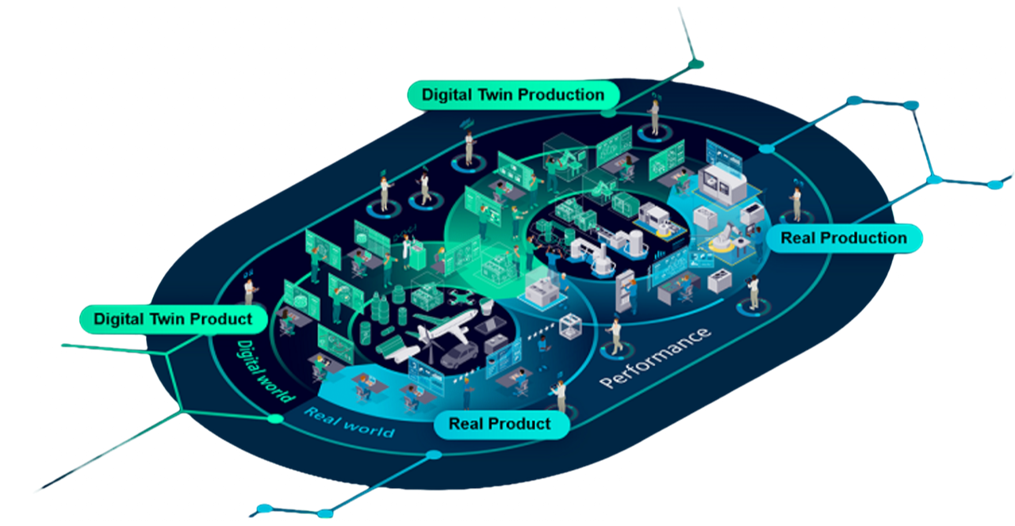
Digital Twin | Impacts on Supply Chain
“A Supply Chain digital twin is a computer model that represents various components and processes involved in the supply chain such as warehouses, transportation networks, and production facilities.”
- anyLOGISTIX
Building and maintaining a digital twin is not a simple network modeling effort. It requires cross-functional collaboration by operations, finance, IT and BI teams at the minimum.
The following steps provide you with a proven methodology for building a digital twin for your supply chain.
- llamasoft
Notes:
Definition of Digital Twin for Supply Chain… I see many different solutions claiming Digital Twin capability, from Advanced Planning Solutions (e.g. SAP IBP, Logility, Kinaxis, o9, John Galt) that may hold a simple network production and distribution model, to network optimization tools (e.g. Llamasoft, Logility/Starboard), to Google Cloud’s Supply Chain Twin, to bespoke systems receiving real-time information from manufacturing equipment (from providers like Siemens and GE). Is there a consensus definition of what does and does not quality as a Digital Twin? Are there attributes or capabilities – a checklist, maybe – that must exist for a solution to claim it is a Digital Twin?
Step 1: Map out processes and/or assets
Organizations might prefer to start with creating an end-to-end digital twin of their supply chain or start with a section as a pilot and then scale it after testing. In either case, the teams in charge of each of the component of the supply chain operations and assets, e.g. transportation (fleets), warehousing, inventory, sourcing etc. should get together to map out the processes and assets to be virtually cloned end-to-end.
Step 2: Determine data sources
Traditional network modeling usually calls for past data and in some cases forecasts and plans. Digital twins on the other hand require real-time data. Therefore, they are generally linked hand in hand to Internet of Things (IoT). As all relevant operational and financial data is identified during the mapping process, the sources and owners of the data should also be identified.
Step 3: Choose hosting technology
There are many critical technological factors when creating and maintaining an IT architecture digital twin. The architecture should allow for connecting to multiple data sources including internal, external and real-time data, and support a wide variety of data formats. It should be scalable to run multiple simulation and optimization scenarios. Security and monitoring should be configured to provide easy access to users with diverse purposes and tasks.
Step 4: Model Supply Chain Twin
The Digital Twin should be built keeping the long-term objectives in mind in a similar fashion to when building supply chain models for optimization and simulation. The structure should allow for simulating and analyzing alternative processes, optimizing asset performances and predict occurrences.
Step 5: Connect to real time data
The two main distinctions of digital twin compared to optimization of simulation modeling is using real time data and minimal data aggregation to allow for detailed visibility. Once the digital twin is built, it is connected to internal as well as external real time data sources. This might require investment in new technologies such as sensors or RFIDs and collaboration with third parties.
Step 6: Simulate, Optimize & Analyze
Opportunities for prescriptive, predictive and advanced analytics using digital supply chain twin to drive decisions range from strategic to operational. Combined with machine learning when applicable, operations and assets can be simulated or optimized to gain insights, test alternative scenarios or become responsive to disruptions. The outputs should be shared across the organization to drive organization-wide action plans.
Step 7: Scale & Enhance
As the digital twin of the supply chain is built piece by piece and tested, it is only bound to evolve and expand. It can be scaled across organization to clone end-to-end supply chains, but when we think about the supply chain holistically, it can go even beyond the borders of the organization connecting with suppliers and customers. The twin can be enhanced with additional real-time data points from internal sources as well as third parties and industry organizations.
And as always, the whole process needs to be well documented in order to maintain, modify and scale.
How would a planning solution utilize real-time information that a Digital Twin can provide? Planning solutions are inherently forward-looking; how can current real-time information that Digital Twin provides be leveraged to support planning (without overwhelming the planning process with continuous change)?
Digital twins are utilized to provide horizontal visibility, identify opportunities by discovering patterns, eliminate inefficiencies by determining root causes, create responsive plans for potential disruptions, optimize current processes and available assets and so much more.
Digital twins can oversee many internal and external moving parts in end-to-end supply chains and build nonlinear supply chain models. More critically, with their ability to compute thousands of what-if scenarios, the technology learns from these decisions and gains maturity over time.
Digital twins are a combination of multiple enabling technologies, such as sensors, cloud computing, AI and advanced analytics, simulation, visualization, and augmented and virtual reality.
Are Digital Twin models that are bring created used primarily for a specific point in a supply chain(e.g. within the walls of a plant or warehouse, from shipment to customer receipt), or are they end-to-end?
https://agillitics.com/7-steps-to-build-your-digital-supply-chain-twin/

Slide 30


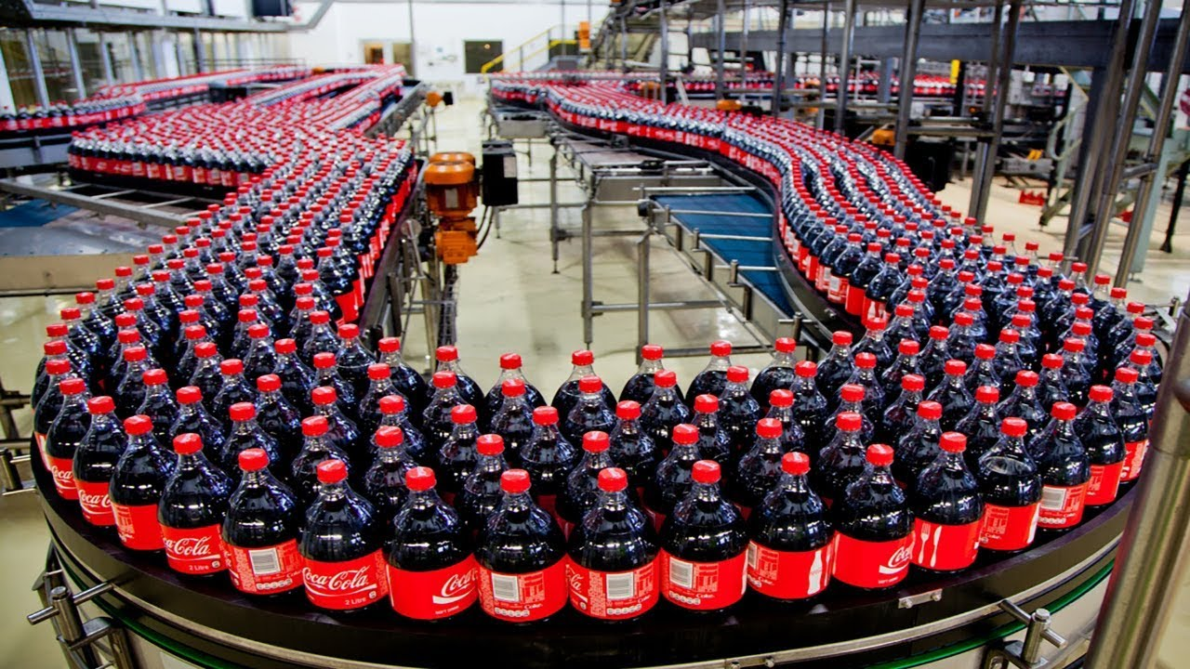
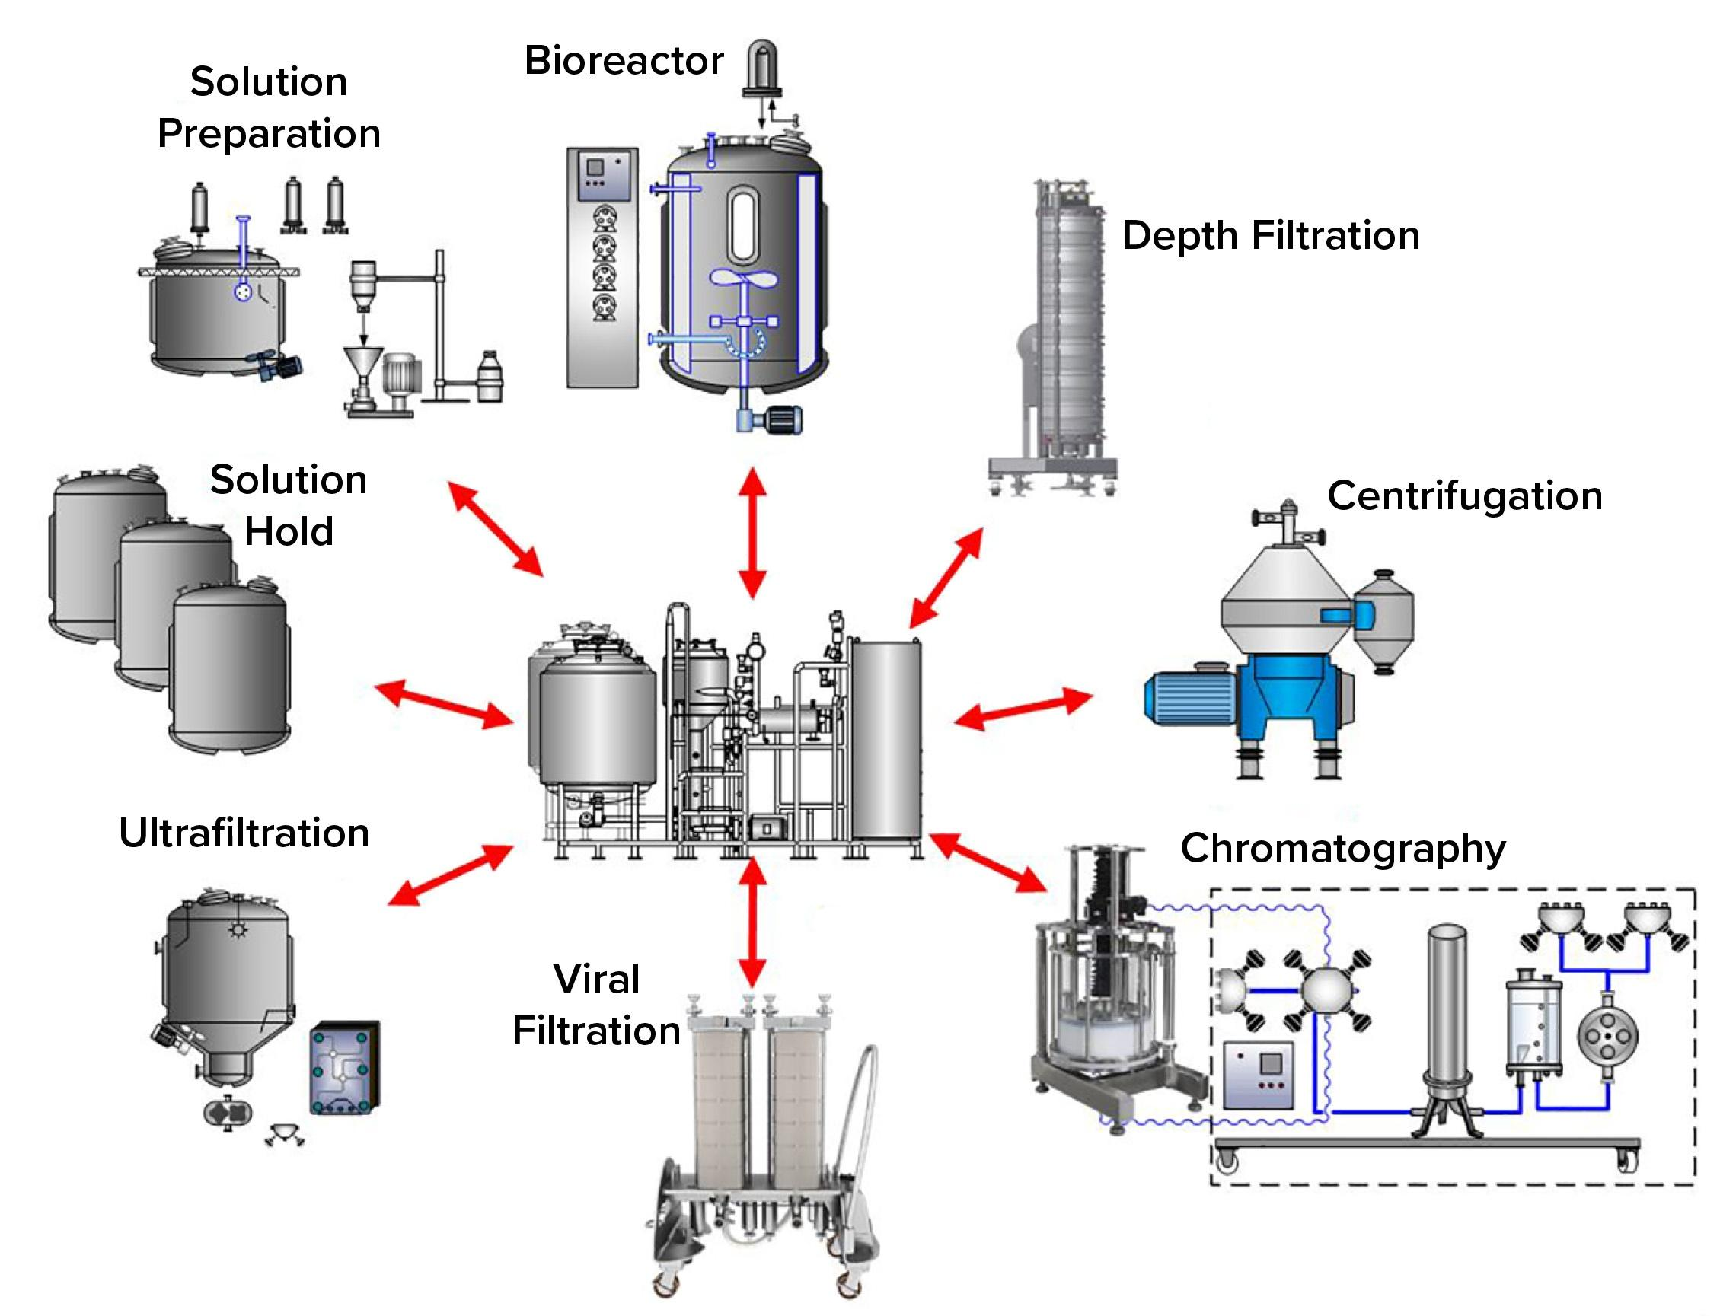
Energy Conservation
Implementation of CIP (Clean in Place) digital twin
SOLUTION
PAIN POINTS
AWS Digital Twin IMPLEMENTATION!
Repeated disassembly of production line to clean the interior surfaces of the production line and equipment.
CCI is modernizing its manufacturing facility by creating a digital plant replica—a digital twin—in the cloud. It hopes to unlock value with advanced analytics, artificial intelligence (AI), and real-time asset monitoring. In fact, CCI has produced a repeatable playbook so other Coca-Cola bottlers can deploy the same digital manufacturing solution in their facilities.

Slide 31
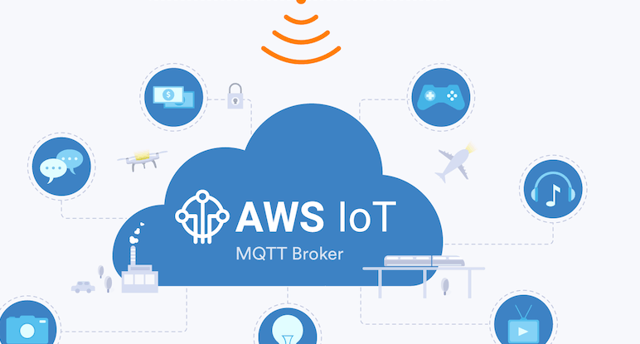
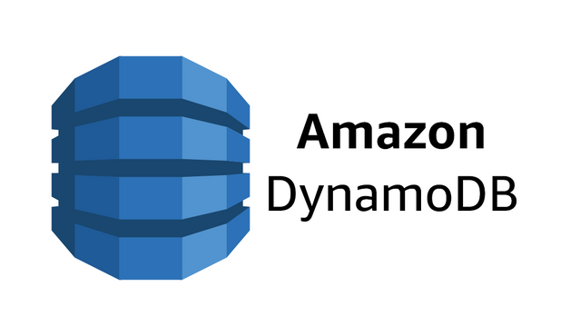


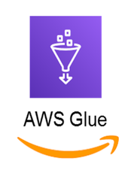
IMPLEMENTERS AND PROCESS
IMPACT
TOUCH POINTS
Identified 20+ points of optimization in its equipment cleaning processes
REDUCE ELECTRICITY
Reduced electricity usage by 20%, annual savings upto 156,000 kWatt for 60 systems.
CUT WATER
Cut water usage by 9%, CCI could save 90,000 tons for 60 systems
PRODUCT QUALITY
Improve product quality by 27% by monitoring temperature, shelf-life and sanitation cycle
TECH IMPLEMENTATION
Data collection from equipment and processes- AWS IOT solutions
Create digital representations to provide real time visibility into the process- Amazon DynamoDB
Create processes to enrich the CIP data in cloud- AWS Lambda, AWS Glue
ADDED DAYS
Added 34 days to its production schedule, thanks to streamlined cleaning process

Slide 32

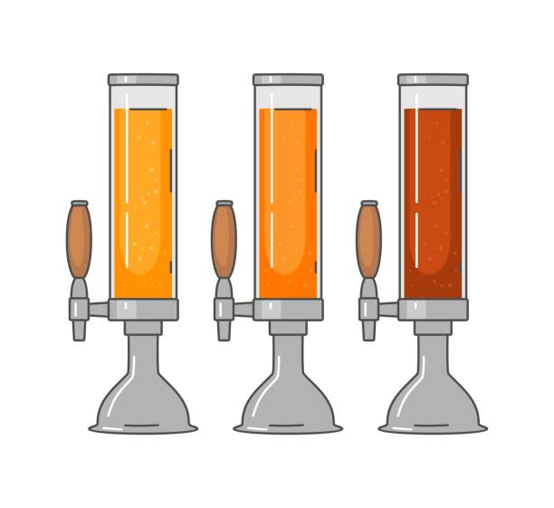
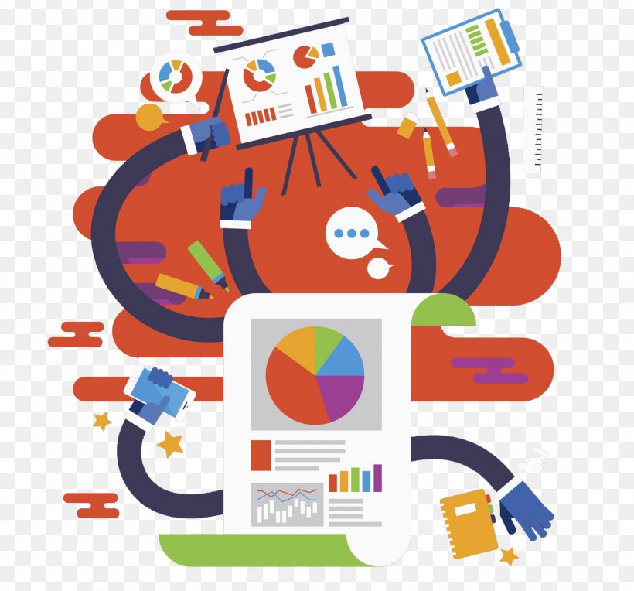

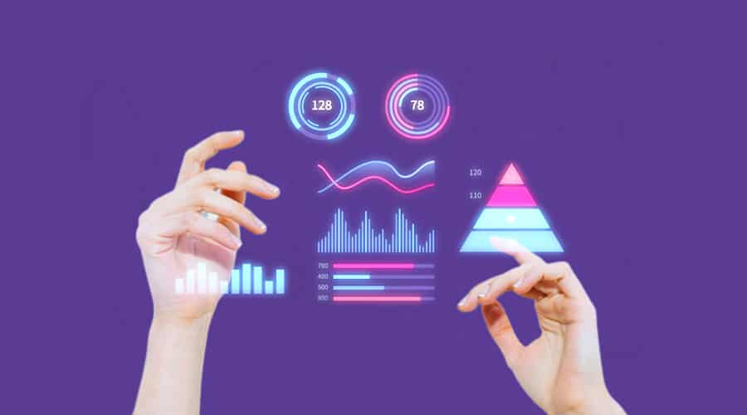
Product Quality & Process
PAIN POINTS
SOLUTION
A connected beverage distribution system called Intellidraught that turns manufactured or already-installed equipment into smart devices that unlock insights where beverages are dispensed.
Final point of contact metrics are a mystery
Questions like which drink is in demand, factors that impact drink quality are unanswered
No visibility into the health of the equipment.

Slide 33

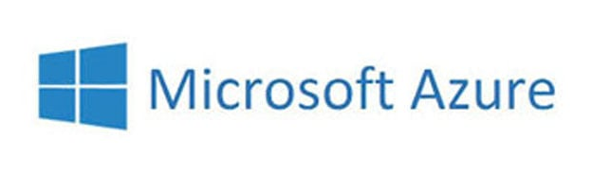

THE INTELLIDRAUGHT!
MICROSOFT AZURE AND PTC THINGWORX
BETTER SELL THROUGH
Achieved 14% greater sell-through via enhanced sales and inventory management
EQUIPMENT FAILURE
€35,000 cost reduction in water and chemical utilization per year
EMPLOYEE OPTIMIZATION
Reduced equipment failures by 13% prevents lost revenue
TECH IMPLEMENTATION
PRODUCT QUALITY
Improve product quality by 27% by monitoring temperature, shelf-life and sanitation cycle
Microsoft and PTC quickly emerged as the ideal IoT partners to create the Intellidraught!
Together, Azure and ThingWorx enabled Celli Group to reduce their time to market and leverage the machine learning, artificial intelligence, and advanced analytics they needed to create smart products.
SERVICE COSTS
Predictive maintenance reduced service costs by 10%

Slide 34
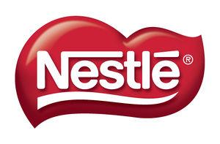
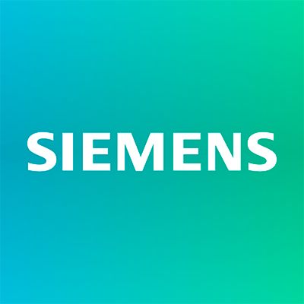

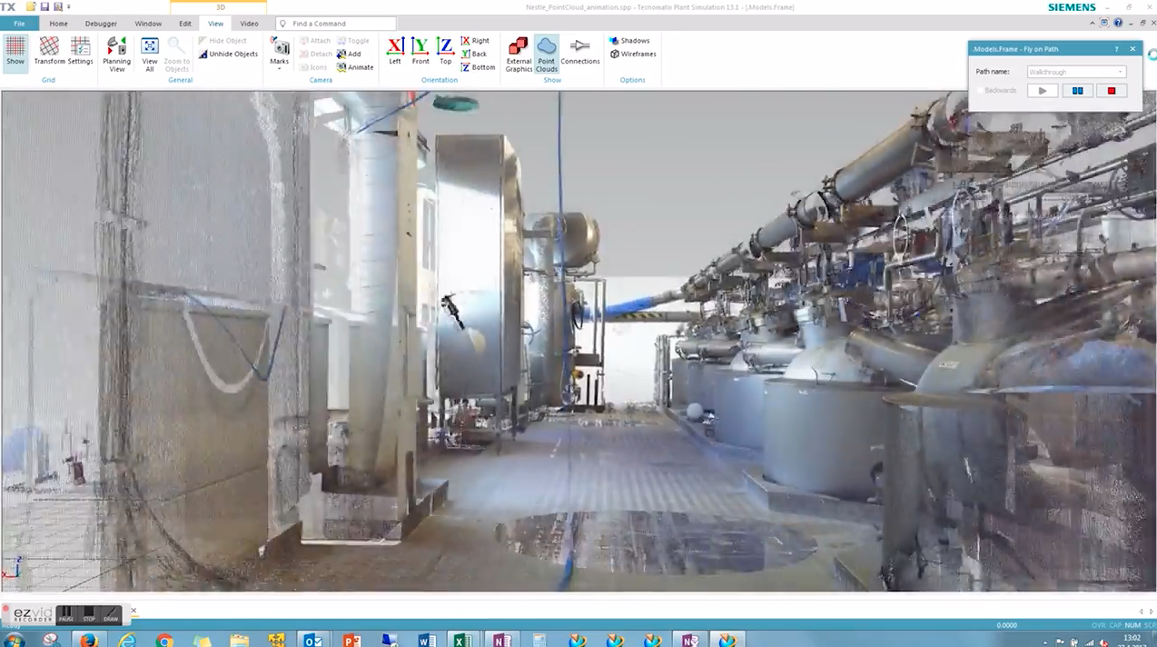



Optimizing Costs
SOLUTION?
JUUKA PLANT PAIN POINTS
SIEMENS Digital Twin IMPLEMENTATION!
Meeting customer demand
Age of the factory
Poor plant efficiency
Outdated automation

Slide 35

SIEMENS’ MINDSPHERE
IMPACT!
HEATING TIME
23% decrease in median kettle heating time
COST REDUCTION
€35,000 cost reduction in water and chemical utilization per year
EMPLOYEE OPTIMIZATION
0.5 FTE annual savings by reducing the number of employees in production planning
TECH IMPLEMENTATION
Digital Twin plant model, used to simulate the material flow in the factory. Plant simulation allows testing and validating different production scenarios.
Digital Twin uses the performance data collected from the factory’s live operation can be used to optimize processes and performance.
Incorporating Siemens’ MindSphere and leveraging digital transformation and industrial IoT as a SaaS increased transparency of processes.
PRODUCTION/COOKING
Helped optimize cooking and clean-in-place (CIP) processes, further reducing production costs.

Slide 36
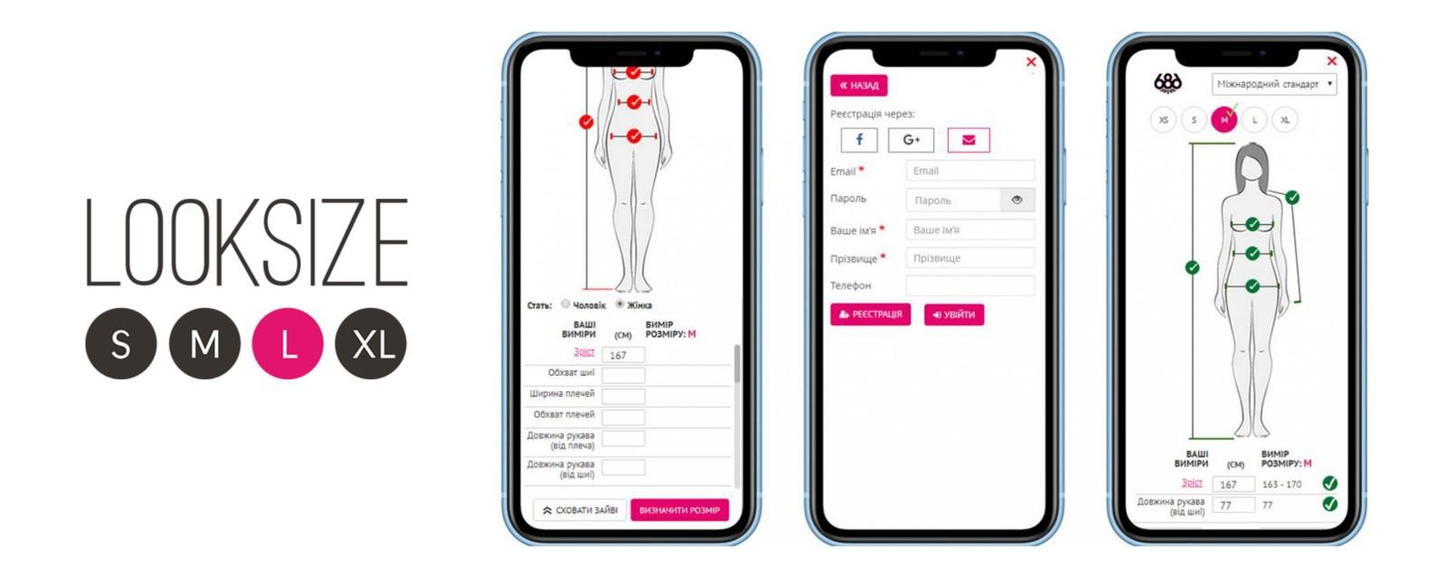
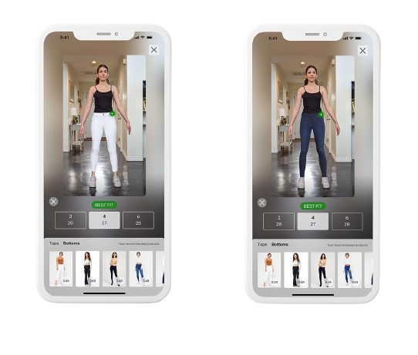
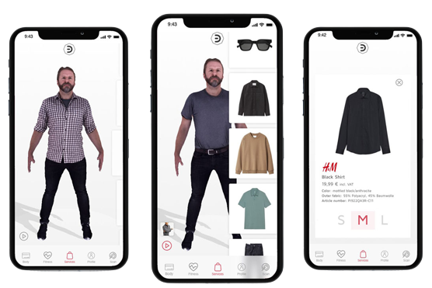
CPG: Virtual Reality & Digital Twinning
“66% of Consumers are Interested in Using AR for help when Making Purchasing Decisions.”
-Shopify
“60% Increase in Purchases Made with Digital Devices”
-Global Digital Shopping Index
“The AR and VR market in retail is set to reach $1.6 billion by 2025.”
-Goldman Sachs
“eCommerce spending reached a total of $3.914 trillion in 2020.”
- Business Insider
It’s predicted that the global virtual fitting room market will grow from $4.03 billion in 2022 to $14.87 billion by 2029. That’s a compound annual growth rate of 13.44%.
-Shopify
Notes:
-Boosting sales
AR technology enables customers to try out products virtually before they buy them – that is, they can see exactly how clothing will fit them or how new furniture will look in their home or office environment. Regardless of whether the customer shops online or offline, AP helps reduce the customer journey and increases store conversions.
-Minimizing returns
AR helps customers avoid disappointment and choose the products that suit them best. Hence, the return rates tend to plummet for both online and brick-and-mortar stores.
-Increasing customer engagement
The virtual experience that augmented reality in retail offers ignites customers’ interest in products while providing all the additional product details they might need. Informed customers tend to come back and shop for more products whenever they get the chance.
-Creating social media content
The AR experience gives customers something to talk about and share on social media. The social media comments and discussions that ensue help increase product and brand awareness.
-Collecting data on customer preferences
The info about the products that customers choose to try through AR-enhanced shopping speaks volumes about their interests, preferences, and patterns of shopping behavior. Retailers may use these insights to deliver personalized advertising and marketing campaigns.
-Delivering a contactless experience
In a post-pandemic world, the applications of AR in retail serve to eliminate the contamination risks and the concerns about hygiene.
-Reducing staffing expenses
AR app offers users exhaustive information about the items they are interested in. Moreover, augmented reality in retail helps them with store navigation, which reduces the need for human shop assistants to a necessary minimum.
-Building customer loyalty
A better customer experience accounts for higher customer loyalty and helps audiences build stronger relationships with brands.
As you can see, there are many ways how companies may benefit from using AR in retail. In the next section, we will talk about the applications of AR in retail stores and online.
https://easternpeak.com/blog/bringing-augmented-reality-to-your-retail-app/
https://www.shopify.com/retail/how-retailers-are-using-ar-technology-to-build-buzz-and-brand-awareness
APPS:
MagicPlan AR Retail App
Lowe’s AR Store Navigation App – Store Navigation
ASOS Virtual Catwalk App
Décor Mattress App – Home furnishing

Slide 37


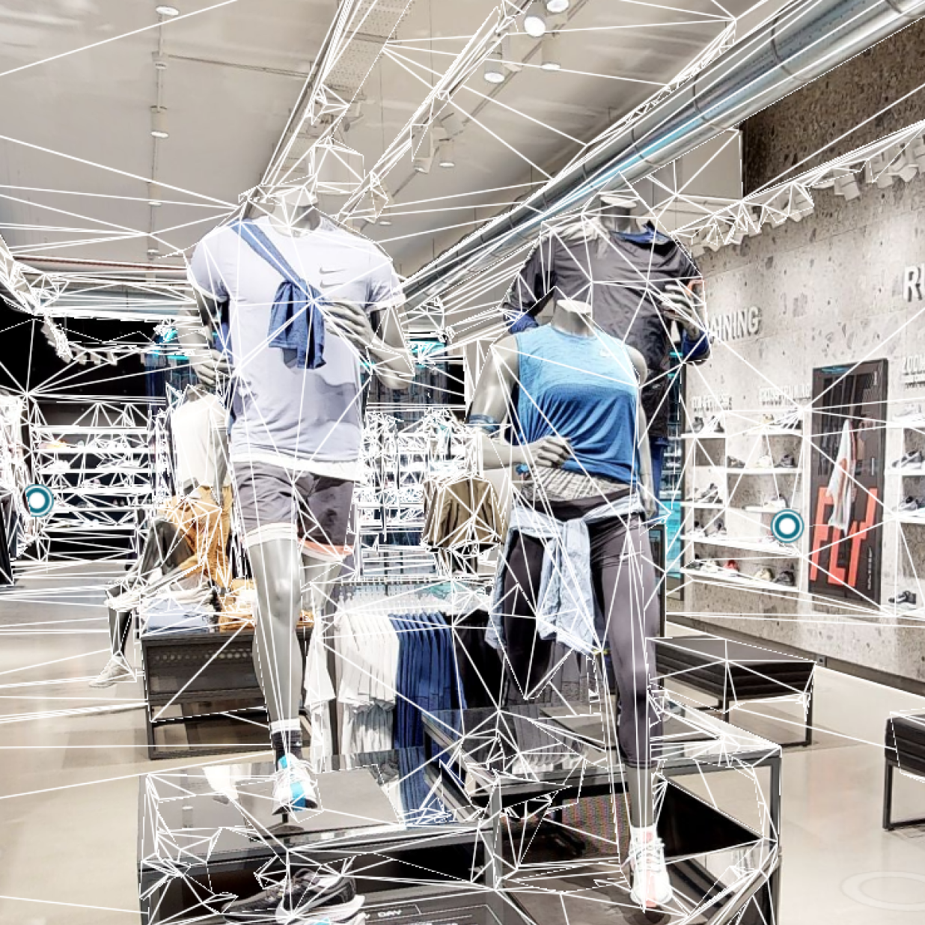
Reshaping Retail
“Millions of buildings in more than 150 countries have been transformed into immersive Matterport digital twins to improve every part of the building lifecycle from planning, construction, and operations to documentation, appraisal and marketing.”
Retail Benefits:
Faster Time to Market
Improved Documentation
Stock Management
Consistent Shopping Experiences
Staff Training
3D Modeling & Data Insight
“Starbucks plans and scopes large rollouts of equipment, decor, and displays in a fraction of the time”
“Home Depot is revolutionizing how they manage stores as we’ve captured the largest Matterport scans ever at 250,000 sq/ft.”
RaceTrac is cutting down time for their store remodels by scoping each project remotely.
Notes:
Matterport is leading the digital transformation of the built world. The Company’s groundbreaking spatial computing platform turns buildings into data making every space more valuable and accessible. Millions of buildings in more than 150 countries have been transformed into immersive Matterport digital twins to improve every part of the building lifecycle from planning, construction, and operations to documentation, appraisal and marketing. The company has been serving the real estate and photography industry since its inception and is also being adopted by major brands in architecture, engineering, construction, facilities management, insurance, restoration, retail, travel and hospitality.
https://matterport.com/industries/case-studies/apex-imaging-services-brings-store-experiences-life-3d-site-survey
Apex:
https://www.apeximagingservices.com/tech-solutions

Slide 38
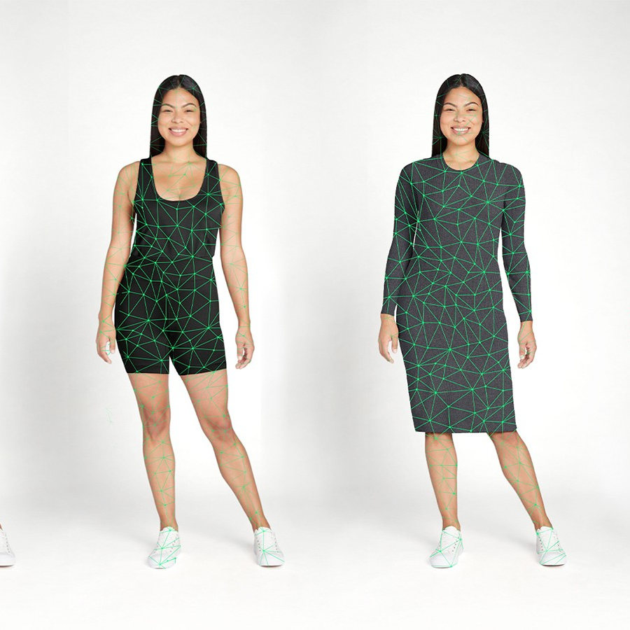
Walmart Acquires ZEEKIT Start-Up
2019, Macy’s signs three-month pilot, followed by full contract.
Increased online sales by 43 percent
Zero items purchased with its assistance were returned.
2021, Walmart acquires Zeekit for $200m, implements Choose My Model & Be Your Own Model features
Features 270,000 items across Walmart’s online portfolio for virtual try-on
Collects data on customers to prioritize like item views and
Notes:
https://www.haaretz.com/israel-news/2021-08-15/ty-article-magazine/the-walmart-deal-meet-one-of-the-only-israeli-women-to-seal-a-nine-figure-exit/0000017f-e5b3-df5f-a17f-ffff038b0000

Slide 39
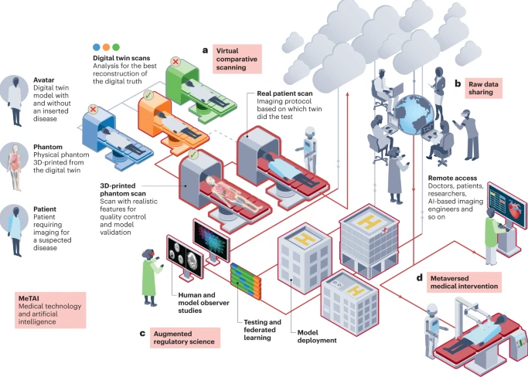
LS Industry Relevant Use Cases
IDENTIFICATION OF RELEVANT USE CASES FOR THE LS SPACE
DRUG MANUFACTURING
AUGMENTED REGULATORY SCIENCE
FDA REGULATION
SUPPLY-CHAIN

Slide 40
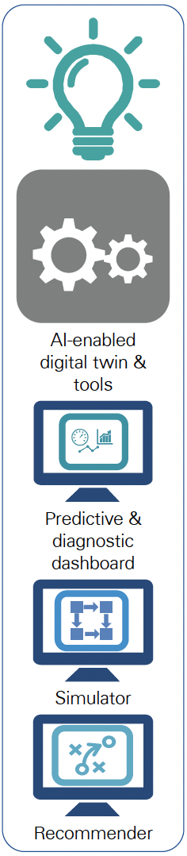
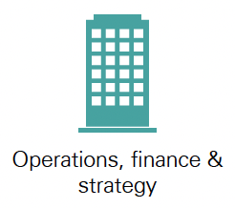
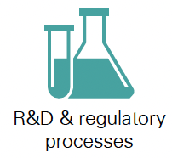
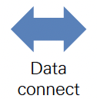
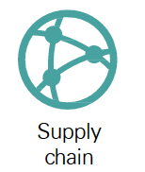

BIG PHARMA : COMPANY X
KPMG: DIGITAL TWIN SOLUTION
CLIENT CHALLENGE
Identified and organized acquired data sources for planning, execution and quality.
Financial Performance
Built multistep predictive models using advanced machine learning algorithms.
Meeting customer demand
Bottlenecks impacting commitments to suppliers
Digital twin transformed Company X from reactive to proactive execution through intuitive, easy to use problem solving tools and data.
Supply chain issues, ranging from environmental, labor and biochemical.
Understand, prioritize, operationalize avenues for performance improvement of lead times service and cost to produce.
Understanding, prioritizing, operationalizing avenues for performance improvement of lead times service and cost-to-produce.
Obtain outcome predictions for duration, yield & rejection, and KPI’s. Reduced step predicted duration by >40%
Notes:
Client challenge
A leading global bio pharma company was experiencing challenges meeting demand for one of their mainstay products, which was impacting commitments as a trusted supplier for their providers and patients that counted on them, as well as their financial performance. Many difficult-to-model factors were potentially affecting the steps in the supply chain, ranging from environmental, to labor and biochemical, and they were struggling to understand, prioritize, and operationalize avenues for performance improvement in the areas of lead times, service levels and cost-to-produce.
Approach and outcome
KPMG worked with the client to rapidly identify and organize acquired key data sources for planning, execution, and quality; built multistep predictive models using advanced machine learning algorithms; and combined them into a multistage discrete event digital twin. The digital twin was a key first step in moving from a reactive to more proactive execution model by providing intuitive, easy-to-use problem-solving tools focused on identifying key factors influencing target performance variation, expected improvements, evaluating potential improvement scenarios, and providing tactical decision support when unexpected events happened during the production cycle.

Slide 41
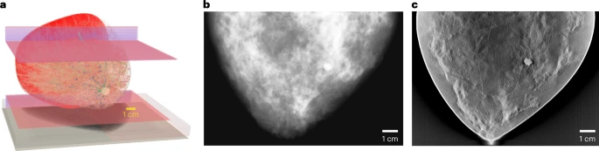
FDA APPROVES DIGITAL TWIN FOR MAMMOGRAM TESTING
STEP 1
STEP 4
FDA team simulated the Virtual Imaging Clinical Trial for Regulatory Evaluation (VICTRE) study for digital breast examinations.
The entire imaging chain was simulated and validated, including virtual patients with and without breast cancer, 2D and 3D X-ray mammographic image acquisition processes and image interpretation.
STEP 2
RESULTS
2,986 in silico patients created to evaluate performance of Digital Breast Tomosynthesis (DBT) as a replacement of full-field digital mammography
The increased lesion detectability of DBT in the VICTRE trial was consistent with the results from a comparative trial using human patients and radiologists that was submitted to the FDA in a pre-market application for approval of a DBT device.
STEP 3
Study demonstrated that simulation tools may be viable sources of evidence for regulatory evaluation of imaging devices.
A virtual breast model (a) corresponding mammography (b) and DBT (c) images simulated with a digital twin of a clinical X-ray imaging device.

Slide 42


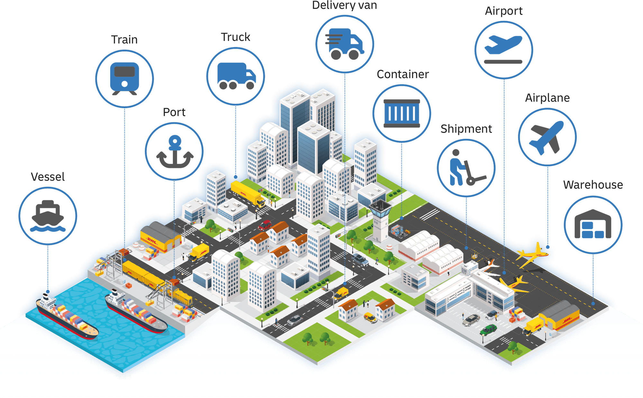


SUPPLY CHAIN EFFICIENCY
SOLUTION
PAIN POINTS
A supply chain digital twin
Slower time to market
Higher costs
Slower decision making

Slide 43
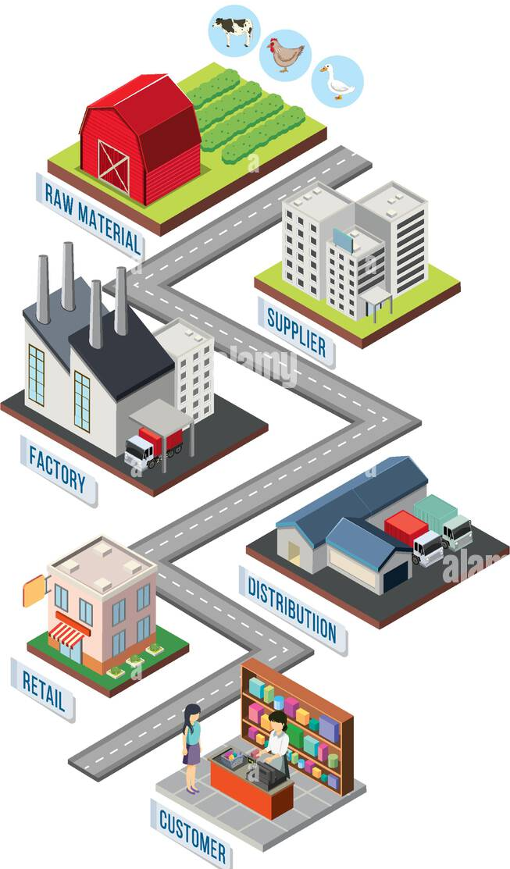

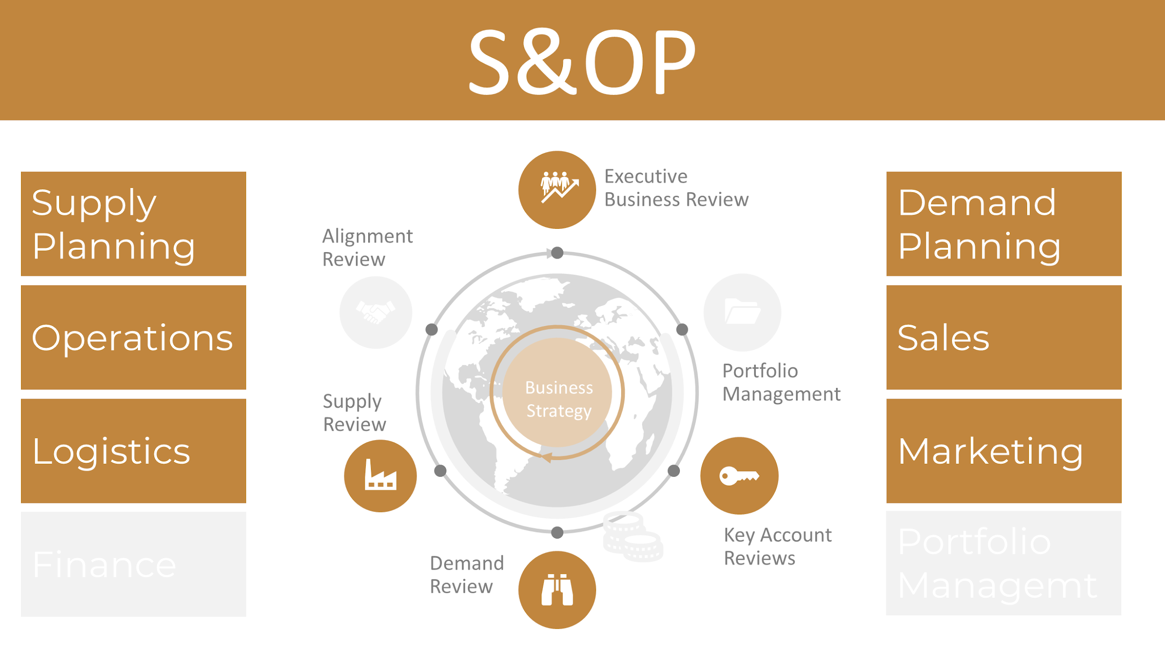

TECH IMPLEMENTATION
IMPACT
For Medtronic, digitalization means implementing three elements
FASTER DECISION MAKING
Make decisions 33% faster
A digital twin- enables Medtronic to make the trade-offs and analyse the scenarios needed to support better decision-making about the supply chain setup.
REDUCTION IN INVENTORY The company reduced its inventory value by $28 million
Integrated business planning (IBP)- in order to get a grip on and adequately respond to the rapidly changing demand.
SAVING COSTS
The company saved us $55 million in costs
A control tower- Lastly, to ensure that the supply chain actually keeps running as intended, Medtronic uses the control tower: “You can’t view these as three separate elements. Together, they form part of a digital ecosystem

Slide 44
IDENTIFICATION OF THE OPTIMUM IMPLEMENTATION ROADMAP

Slide 45


IMPLEMENTATION PROCESS
Now that we know the benefits of digital twin, how do we effectively implement it?

Slide 46

Digital Twin | Implemented Process Flow
Identify – Identify areas within the business, product, process flow or supply chain that needs improvement
Pilot – Pilot the digital twin model on the specific focus area
Grow – Mature the pilot stage into full maturity
Scale – Incorporating software into additional aspects of the business model
Assess – Assess the data collected to determine
adjustments or improvements to the systems
Analyze – Analyze the data collected to
determine how to more efficiently
improve KPIs
Repeat– Continuously repeat cycle
improving machine learning
Identify
Repeat
Pilot
Analyze
Grow
Assess
Scale
Notes:
https://www.mckinsey.com/capabilities/mckinsey-digital/our-insights/digital-twins-how-to-build-the-first-twin
https://www.yokogawa.com/library/resources/white-papers/what-are-digital-twins-and-why-should-process-enterprise-stakeholders-care/
Identify – Identify areas within the business, product, process flow or supply chain that needs improvement
Pilot – Pilot the digital twin model on the specific focus area
Grow – Mature the pilot stage into full maturity to run and collect more data
Scale – Start incorporating software into additional aspects of the business model
Assess – Assess the data collected to determine if any adjustments or improvements need to be made in the systems
Analyze – Analyze the data collected to determine how to more efficiently improve KPIs
Repeat– Continuously repeat cycle – improving machine learning

Slide 47

Digital Twin Capabilities Periodic Table

Slide 48

Architecture for Digital Twins

Slide 49

Architecture Implemented Using Experts

Slide 50
EXPERTS ACROSS EACH STEP

Slide 51







MAJOR INDUSTRY PLAYERS
DEVELOPER PLATFORMS
KEY DEVELOPERS
General Electric
GE Digital
Microsoft (US)
Microsoft Azure
Siemens (Germany)
Digital Enterprise Suite
Amazon Web Services
AWS IoT TwinMaker
ANSYS (US)
ANSYS Twin Builder
Dassault Systemes
3DExperience
PTC
Vuforia - Thingworx
NVDIA
Omniverse
Notes:
https://www.marketsandmarkets.com/Market-Reports/digital-twin-market-225269522.html

Slide 52








Digital Twin | Adopters
CONSUMER PRODUCTS
LIFE SCIENCES
Unilever- Increasing Product Quality and De-Risking Decision Making
Boston Scientific- Connect patients more quickly to care and democratize health care
Coca cola- Fueling Sustainability Goals and Streamlining Performance
Medtronic- Touchless patient monitoring, model real organs for testing purposes
Abbott - Medical device, Predictive Analytics Improve Check-Up Attendance
Kraft Heinz- Reducing Downtime
Philips Healthcare- Test resilience strategies, dynamic virtual model of medical devices, Remote monitoring
Johnson and Johnson- Reducing Time to Market
Notes:
https://www.marketsandmarkets.com/Market-Reports/digital-twin-market-225269522.html

Slide 53
Consumer Products
Perform complex simulations of products and systems in a virtual environment
Optimize product performance, reduce development time and cost, and improve overall product quality.
Manage product development processes, from ideation to retirement, in a single, centralized system
Provide tools and functionalities to manage data and workflows, collaborate across teams and departments, and track progress and performance.
Industrial IoT platform that can be used for collecting and analyzing data from various sensors and devices connected to the product, which can help in creating a digital twin
Digital manufacturing software that can be used for creating virtual models of the production line, which can help in creating a digital twin of the manufacturing process
CAD/CAM/CAE software that can be used for designing and simulating various product applications, including consumer products

Slide 54




Consumer Products
Platform for product lifecycle management (PLM) that can be used for managing product data and digital twins throughout the product life-cycle
CAD/CAM/CAE software that can be used for designing and simulating various product applications, including consumer products
Used to simulate the performance of various consumer products, such as household appliances, sporting goods, and personal care products.
Simulation capabilities can help optimize product performance, reduce development time and cost, and improve overall product quality.
Digital manufacturing software that can be used for creating virtual models of the production line, which can help in creating a digital twin of the manufacturing process

Slide 55





Consumer Products / E-Commerce
Industrial Internet of Things (IIoT) platform that can be used to create and manage digital twins of various product applications, including consumer products
Create a 3D CAD model of a physical product, which can then be used as the basis for a digital twin.
Used to simulate the performance of a consumer product in a virtual environment such as heat transfer, structural integrity, and fluid dynamics.
Product lifecycle management (PLM) software that can be used for managing product data and digital twins throughout the product life-cycle.
Augmented reality (AR) platform that can be used to create interactive experiences and visualize digital twins of products in real-world environments.
An industrial connectivity software that can be used to collect and integrate data from various sensors and machines

Slide 56




Life Science
Platform for building, validating, and deploying digital twins. It includes tools for modeling, simulation, and analytics and can be used for medical devices, drug development, and patient simulations.
Computational fluid dynamics (CFD) software that can be used for modeling fluid flow, heat transfer, and chemical reactions. Used in drug delivery, bioreactors, and medical devices.
Finite element analysis (FEA) software that can be used for modeling and analyzing the mechanical behavior of structures, fluids, and Multiphysics systems. Used for implant design, tissue mechanics, and medical devices.
Software tool for simulating complex, nonlinear, and transient phenomena in biomedical applications. Used for Crash and impact analysis, Biomechanical modeling, and Medical device design
Software tool for modeling complex chemical kinetics and reacting flow problems such as Combustion modeling, Chemical reaction modeling, and Atmospheric chemistry modeling.

Slide 57




Life Science
HyperMesh is a software tool for finite element modeling and meshing, which enables users to create and modify complex 3D models of biomedical structures, such as bones, implants, and soft tissues, and prepare them for simulation using FEA methods
HyperWorks is a suite for simulation and optimization, which includes tools for FEA, computational fluid dynamics (CFD), and electromagnetics simulations. Can be used for medical device design and optimization, drug delivery simulations, and patient-specific simulations
Finite element analysis (FEA) software that can be used for modeling and analyzing the mechanical behavior of structures, fluids, and Multiphysics systems. Used for implant design, tissue mechanics, and medical devices.
FEKO is used for electromagnetic simulations, which enables engineers and researchers to model and simulate electromagnetic fields in and around biomedical devices, such as MRI machines, pacemakers, and other medical implants.

Slide 58




Manufacturing
Enterprise asset management (EAM) software platform that is used to manage asset lifecycle and maintenance processes. The platform includes tools for managing asset data, workflows, and analytics.
Internet of Things (IoT) platform that is used to collect and analyze data from manufacturing processes. The platform includes tools for data management, visualization, and analytics.
Real estate and facilities management software platform that is used to manage space and facilities processes. The platform includes tools for managing space data, workflows, and analytics.
Software platform that is used to manage product development and manufacturing processes. The platform includes tools for managing product data, processes, and workflows, as well as collaboration and communication tools.

Slide 59




HealthCare
Real-time monitoring of patient, staff, and equipment data.
Advanced analytics and machine learning algorithms for insights and optimization.
Collaboration and coordination across departments and locations.
A cloud-based platform that is used by GE Healthcare to manage and analyze data from digital twin models. This software allows for real-time monitoring and analysis of device performance, which can help to improve operational efficiency and reduce downtime.
It is a digital platform that is used by GE Healthcare to develop and deploy new digital twin solutions for healthcare. Allows for the creation of new applications and services used to improve patient outcomes and reduce costs in healthcare.
A healthcare information technology platform that is used by GE Healthcare to manage and collaborate on digital twin projects. This platform allows for the sharing of data and models across teams and departments, which can help to streamline development and improve efficiency.

Slide 60





Construction
Allows for the creation of a digital twin of a construction project, which can be used to improve design, construction, and maintenance.
Allows for the creation of 3D models of buildings and infrastructure projects.
A design and drafting software solution that can be used to create 2D and 3D models of buildings and infrastructure projects.
A simulation tool that allows for the analysis of building performance and energy use. Insight can be used to simulate different scenarios and optimize the design of a building and can be integrated with BIM software to create a digital twin of the project.
A reality capture solution that allows for the creation of 3D models of existing buildings and infrastructure. ReCap can be used to capture real-world data and integrate it with BIM software to create a digital twin of a project.

